Slide 1
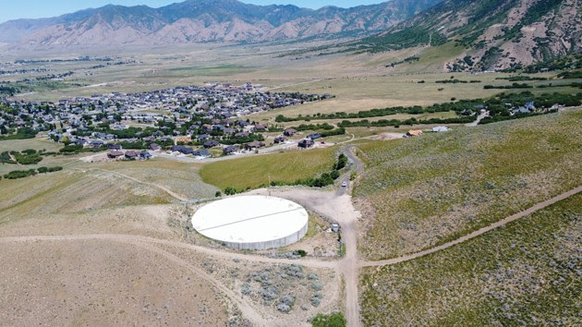

TOOELE CITY PUBLIC WORKS DEPARTMENT
WATER CONSERVATION
MONDAY WITH THE MAYOR MAY 2, 2022
Notes:
Assigned To: Mayor Debbie Winn
INTRODUCTION
Monday with the Mayor
Water Conservation Presentation
May 2, 2022
7:00 PM

Slide 2
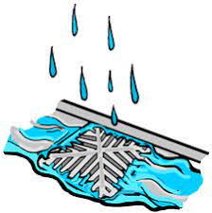
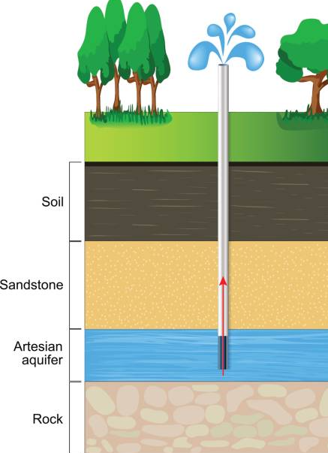
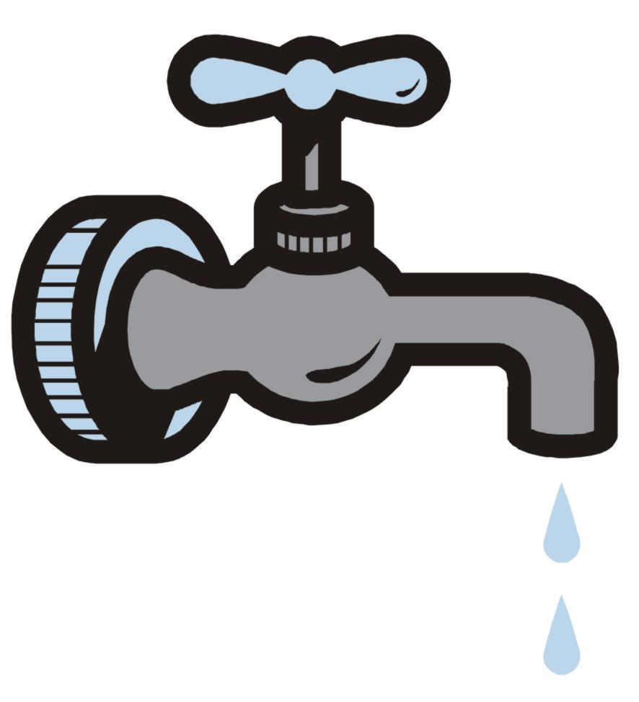
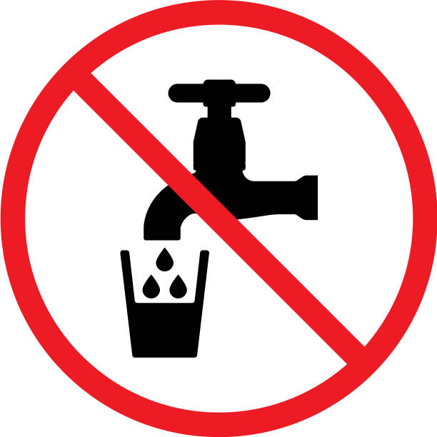
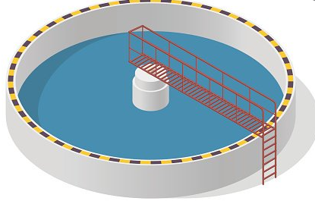

UNDERSTANDING the LINGO
AQUIFER
STORM DRAIN SYSTEM
CULINARY WATER/POTABLE WATER
REUSE WATER/SECONDARY WATER
WATER RECLAMATION
WASTEWATER
SURFACE WATER
GROUND WATER
WATER CONSERVATION MONDAY WITH THE MAYOR MAY 2, 2022
Notes:
Assigned To: Mayor Debbie Winn
(note to PowerPoint operator: double click each term for icon transition)
The following is a list of common terms used in water conservation:
AQUIFER: An underground basin where water is stored after percolating down through many layers of rock and gravel. These basins are dark, and bacteria cannot live in them. The water in aquifers is clean and safe for drinking without adding any chemicals.
STORM DRAIN SYSTEM: Network of structures, channels and underground pipes that carry stormwater (rain water) to ponds, lakes, streams and rivers. BOX CULVERTS are a closed conduit of rectangular cross section used to pass floodwaters under a highway or railroad.
CULINARY WATER/POTABLE WATER: Water that meets drinking water standards for human consumption.
REUSE WATER/SECONDARY WATER: Water that has gone through a sewage treatment plant and is then re-used for irrigation or other purposes. NOT for human consumption. Secondary water can be used for lawns/gardens.
WATER RECLAMATION: The treatment and management of wastewater to produce water of suitable quality for additional use.
WASTEWATER: Used water that comes from homes and businesses.
SURFACE WATER: The water that rests on top of the earth in streams, lakes, rivers, oceans and reservoirs.
GROUND WATER: Water that has seeped beneath the earth's surface down through soil materials to become groundwater. This is accomplished naturally by rainfall and also artificially by humans.
* NEXT SLIDE Jamie will further discuss SURFACE AND GROUND WATER

Slide 3
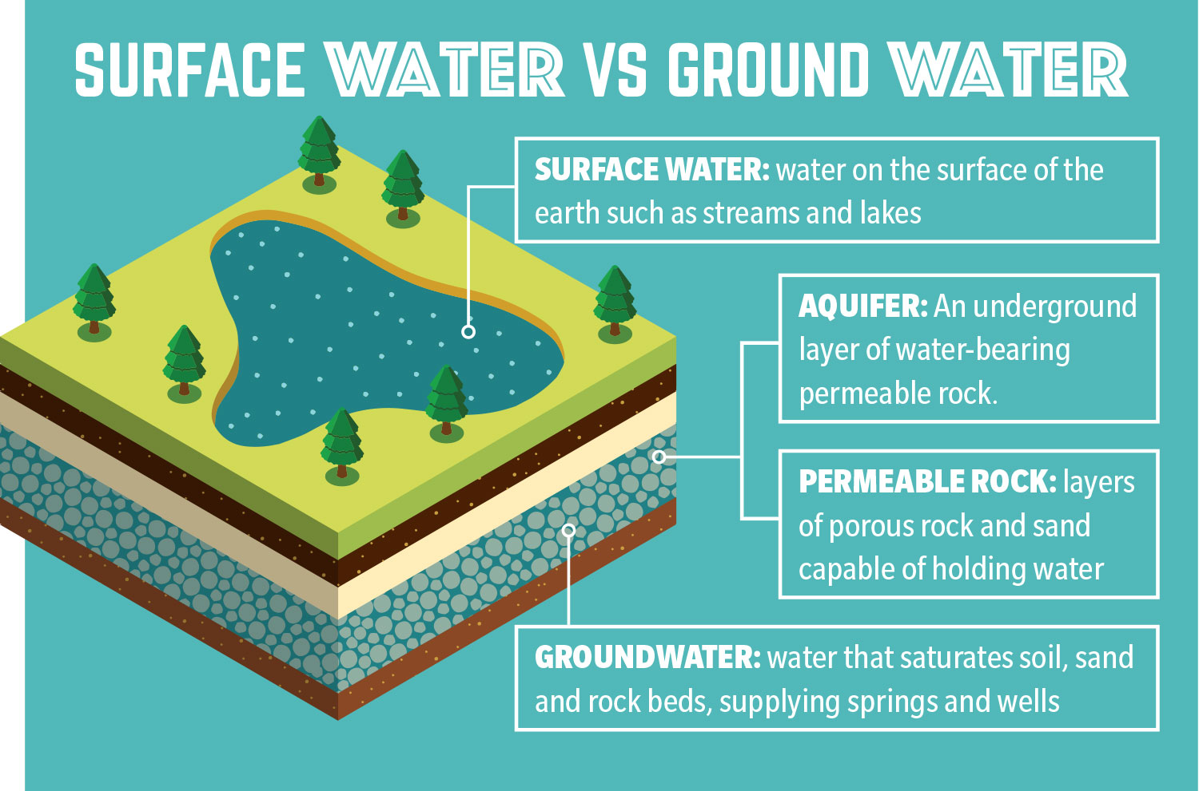
Where does Tooele City Culinary Water Come From?
WATER CONSERVATION MONDAY WITH THE MAYOR MAY 2, 2022
Notes:
Assigned To: Jamie Grandpre, Public Works Director
Where does Tooele City water Come From?
Ground Water - Tooele City water comes from ground water; all Tooele city culinary water come from wells that are located in the aquifers and is considered ground water.
Surface water – Tooele City does not have any surface water sources for culinary water. An example of this would be Settlement Canyon Dam which is not a drinking water source for Tooele City.
Settlement canyon is irrigation water. To use this water you must be a shareholder. This water company is not owned by Tooele city however does have an impact on the City if they have restrictions.

Slide 4
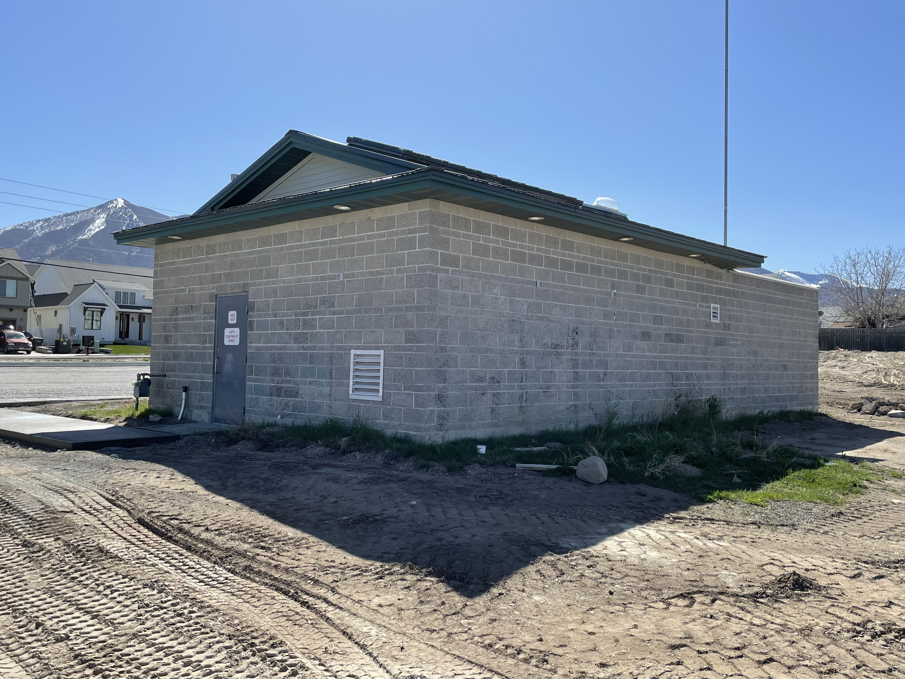
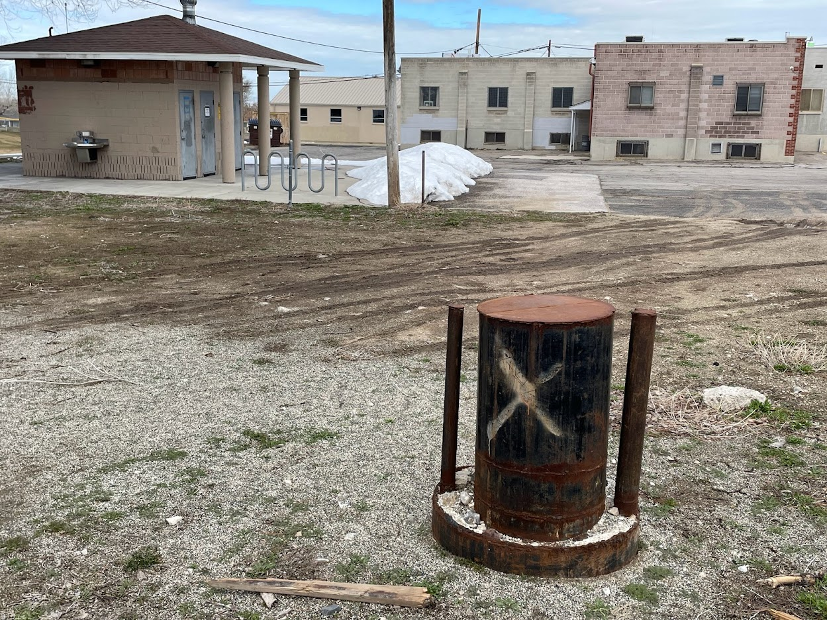
TOOELE CITY GROUND WATER WELLS
England Acres Wellhouse/Booster Station
Red Del Papa
Wellhead
WATER CONSERVATION MONDAY WITH THE MAYOR MAY 2, 2022
Notes:
Assigned To: Jamie Grandpre, Public Works Director
Pictured left: ENGLAND ACRES well house and booster station.
Picture right: Tooele City’s RED DEL PAPA and future Wellhead/Well House Site.
BERRA WELL (not pictured) will be a new well for Tooele City.
Tooele is currently researching new well site locations.

Slide 5
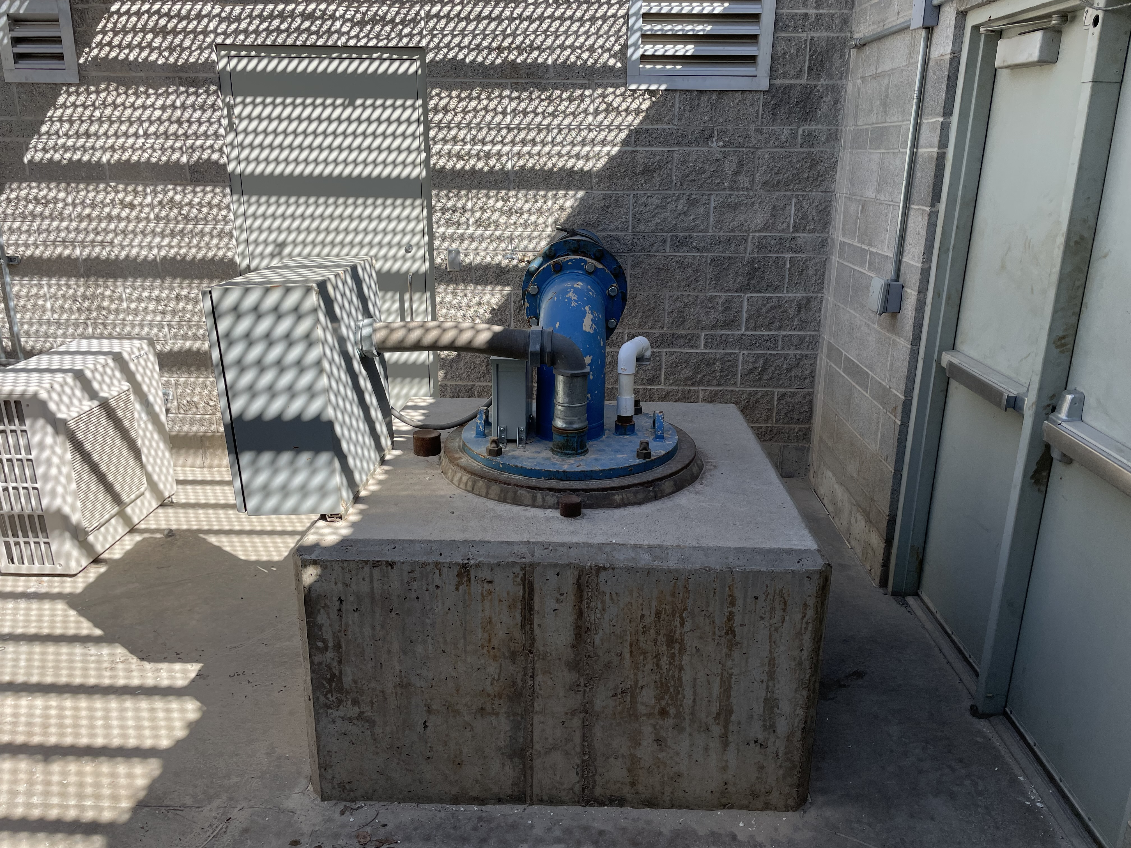
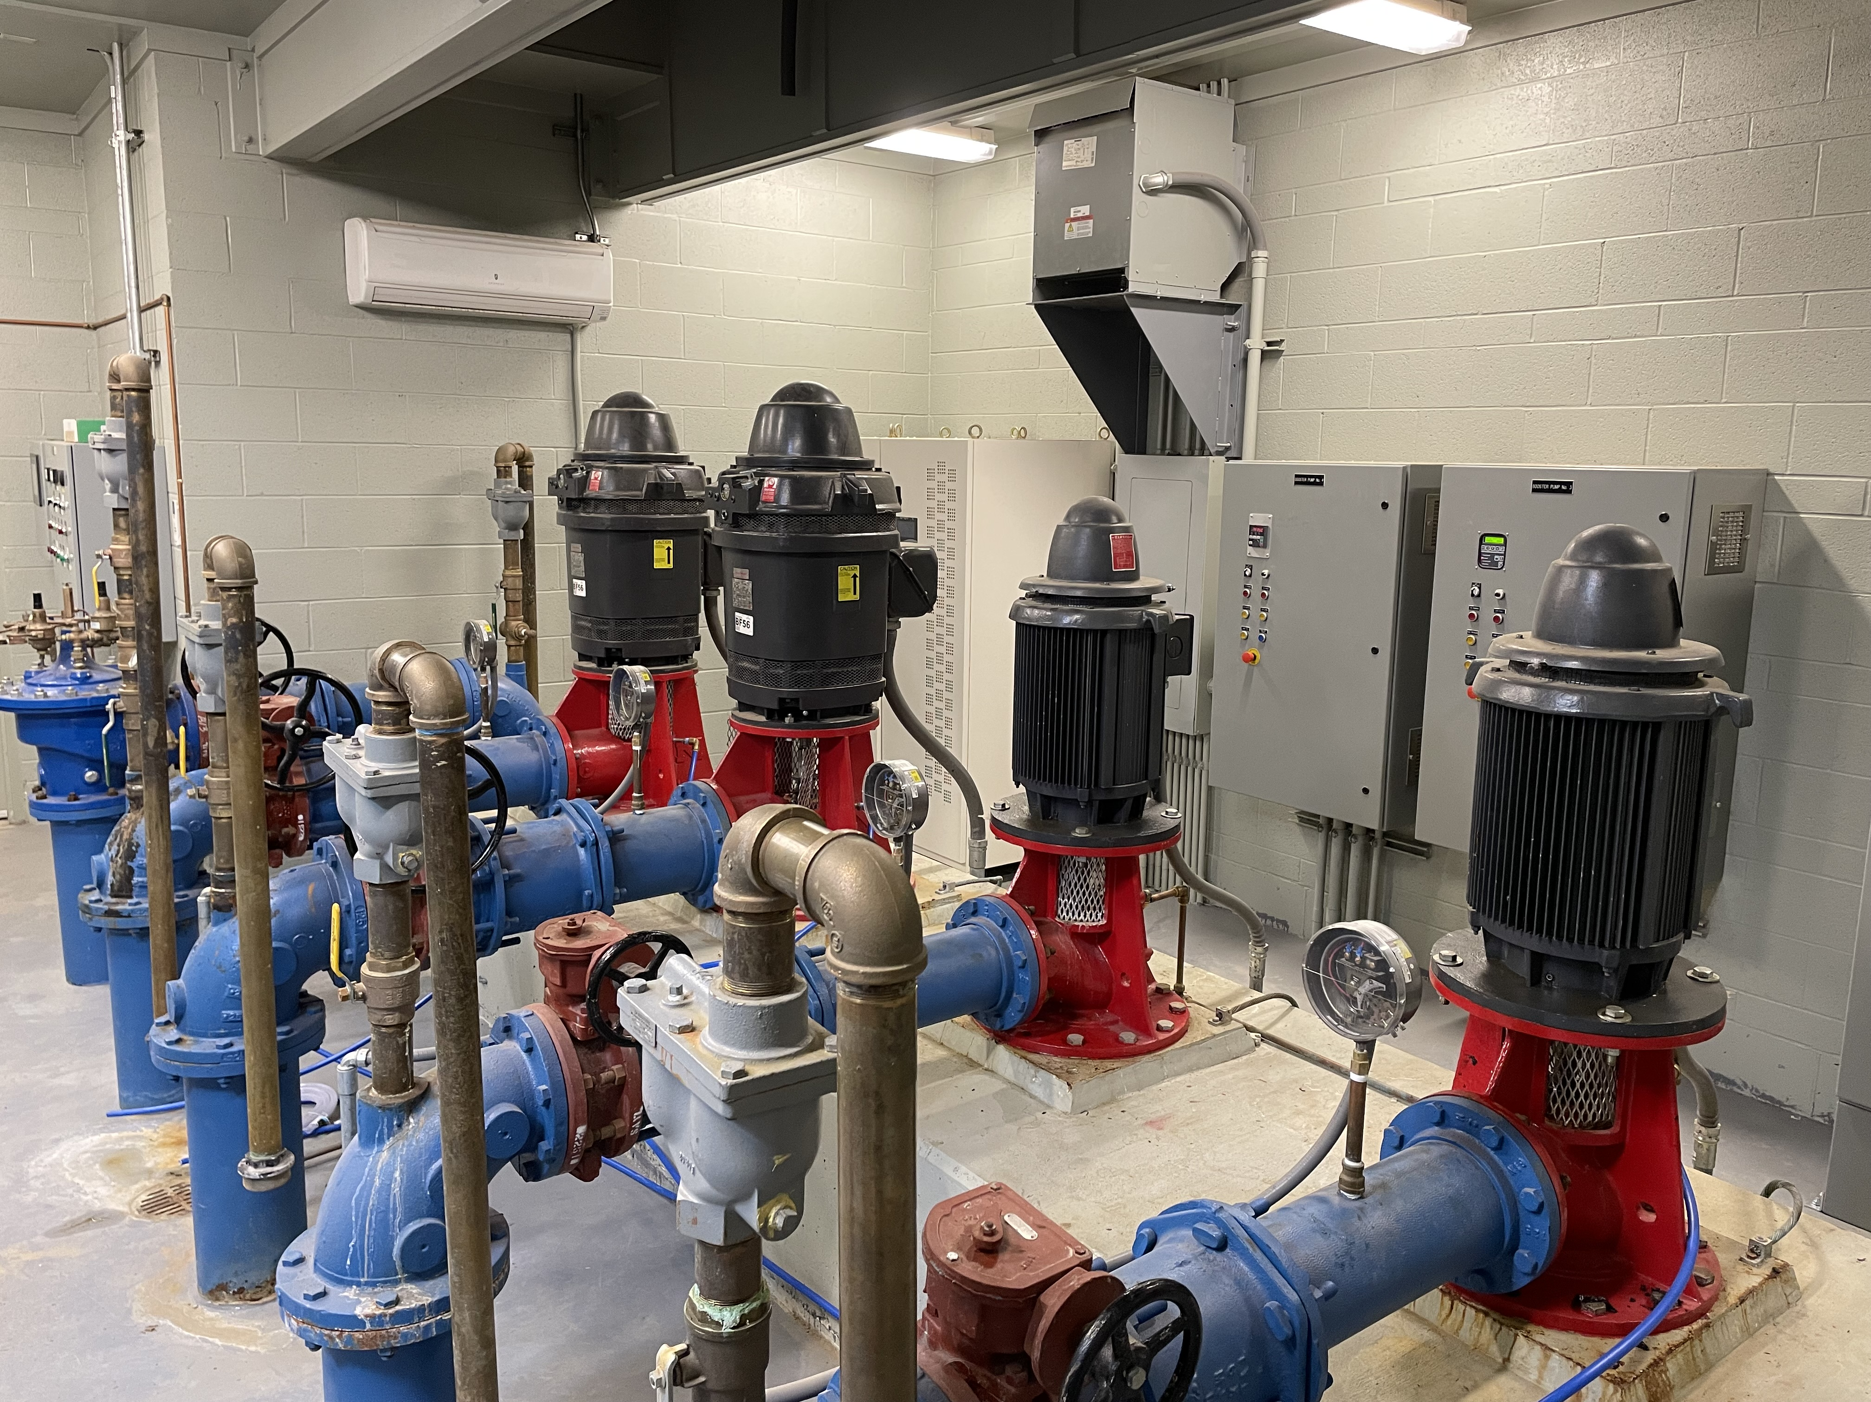
TOOELE CITY GROUND WATER WELLS
England Acres
Well Head
England Acres
Booster Pumps
WATER CONSERVATION MONDAY WITH THE MAYOR MAY 2, 2022
Notes:
Assigned to: Jamie Grandpre, Public Works Director
Photos show Inside England acres Well and Booster Pumps.
Pictured Left: England Acres Well head, pulling water from aquifer.
Pictured Right: Booster pump runs water into the Tooele City’s water system

Slide 6
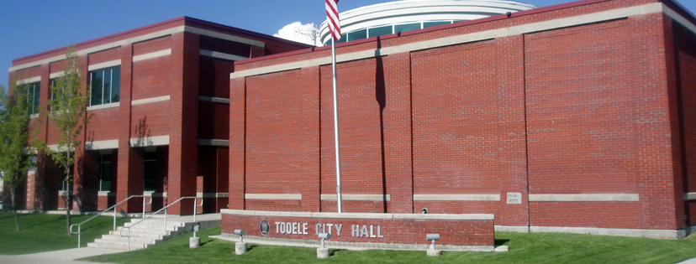
What is Tooele City doing to Conserve Water?
WATER CONSERVATION MONDAY WITH THE MAYOR MAY 2, 2022
Notes:
Assigned to: Darwin Cook, Parks and Recreation Director
WHAT IS TOOELE CITY DOING TO CONSERVE WATER?
Toole City Departments are working collectively to reduce water:
Tooele City Hall we are working to implement drought tolerant landscaping around the property.
Public works Department monitors tank levels daily during summer months.
As we receive data, what will tell us if we need to look at restrictions for our City.
If data shows significant decrease in water, one of the first restriction adjustments will be to outdoor watering.
Parks & Recreation
Replacing park strips
Automated sprinkler system water wise controllers
Removed sprinkler heads replacing with smart water wise heads
Goal within upcoming year to reconnect more secondary water
Turf will be mowed no shorter than 3 ½ in. on sports fields and 5 in. on passive recreation areas.

Slide 7
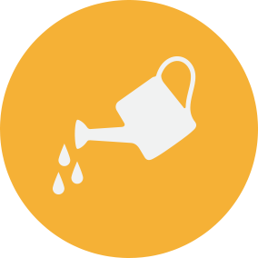
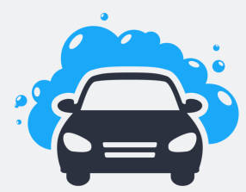

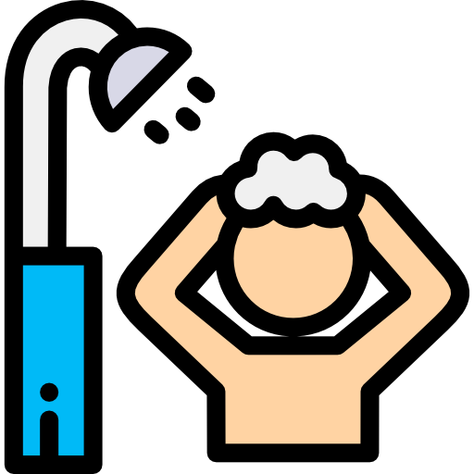
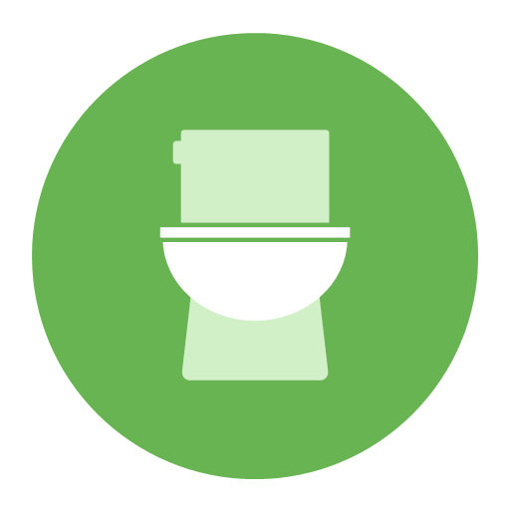
How Can I Conserve Water?
Water Early morning/evening
320 = daily # of Gal. used by a family of (4)
CARWASH SAVES MORE WATER THAN WASHING in driveway
Encourage water conservation
Take a five minute shower vs bath
leaky toilet wastes more water per day than washing dishes, running garbage disposal or taking a long shower
It is not okay to flush items down the toilet such as:
cotton balls, wipes, tissues, etc.
WATER CONSERVATION MONDAY WITH THE MAYOR MAY 2, 2022
Notes:
Assigned to: Darwin Cook, Parks and Recreation Director
The best time to water is early morning or evening when it’s cooler. Watering the yard when it’s really hot outside cause the water to evaporate before the plants have time to drink it. The average home use the most water
during the hotter months for outdoor watering.
The average family of four uses 320 gallons of water every day. How can a small family use so much water? It may seem hard to believe, but the average American uses more than 80 gallons of water each day to do things like flush toilers, run the faucet, and water plants. That’s enough to fill more than 1,200 glasses of water! 75% of the earth’s surface is covered in water, but most of it is salt water so you can’t drink it. It is very important to save the water we use everyday because less than 15 of the earth’s water can be used by people.
The best way to save money when washing a car is not in your driveway. Many car washes can save more water than if you wash you car at home. They do this by recycling the water that they use instead of letting it run down the sewer drains. Look for “water-efficient’ car washes. If you do wash it at home, use a bucket instead of letting the hose run.
To help conserve water in your household, encourage water conservation in simple ways. For example, brushing your teeth can waste up to 8 gallons of water by leaving the faucet on when you brush your teeth in in the morning and before evening. Teach household members to turn off the tap. A bucket, broom and clock are all water saving tools.
A bucket can be used under the tap while you make the water the right temperature. The water collected can be used to water plants or fill up your pet’s water blow.
Use a broom instead of the hose to clean your driveway or sidewalk.
Keep a clock nearby to keep your showers under five minutes. Taking a 5 minute shower uses less water than taking a bath. It takes 70 gallons of water to fill a tub but only 10 to 13 gallons for a five minute shower. If you do take a bath, put the stopper in the drain right away and change the temperature as you fill the tub.
Leaky Toilet wastes the most water per day in an average household. It can waste about 200 gallons of water every day! You can test your own toilet to check for leaks. Place a drop of food coloring in the tank and if the color shows in the bowl without flushing, you have a leak.
It is NOT okay to flush trash down the toilet like cotton balls, q-tips, wipes, and tissue. Unnecessary flushing can save a lot of water, and avoid flushing items that don’t come from bodily waste/toilet tissue.

Slide 8
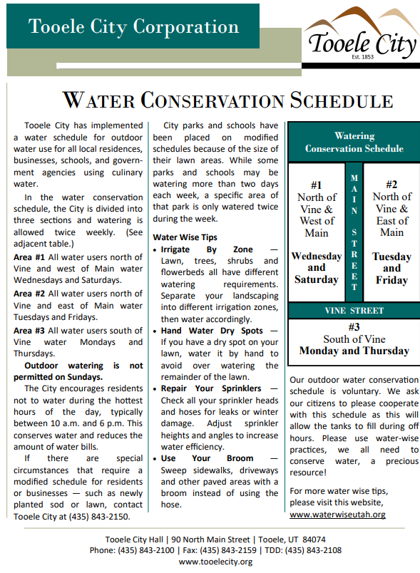
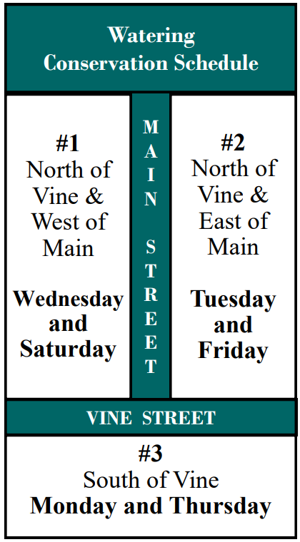
WATER CONSERVATION SCHEDULE
Outdoor watering Not Permitted Sundays
Irrigate By Zone
Hand Water Dry Spots
Repair Your Sprinklers
Use Your Broom
For more tips visit:
www.waterwiseutah.org
WATER CONSERVATION MONDAY WITH THE MAYOR MAY 2, 2022
Notes:
Assigned to: Councilman Justin Brady
Tooele City Water Conservation schedule can be found at:
https://tooelecity.org/city-departments/finance/utilities/water-schedule/
Outdoor Watering Not Permitted Sundays
Irrigate By Zone
Hand Water Dry Spots
Repair Your Sprinklers
Use Your Broom, as mentioned by Darwin, we can use other items, such as a Broom, to aid in our water conservation efforts.
The Water Schedule is currently voluntary.
In order to preserve our most precious resource, Tooele City has implemented a voluntary outdoor watering schedule for outdoor water use for all local residences, businesses, schools, and government agencies using culinary water.

Slide 9
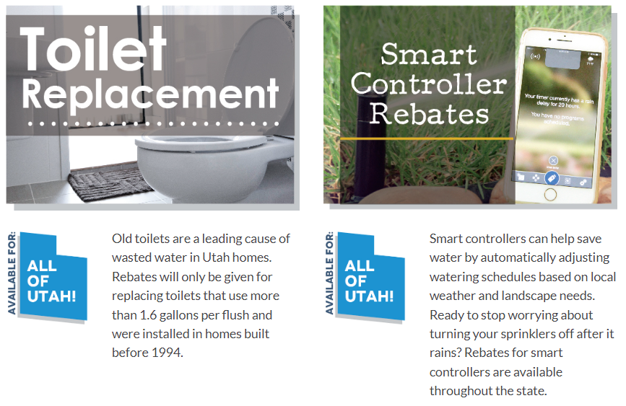
UTAH PROGRAMS AND REBATES
UTAH WATER SAVERS WEBSITE
https://utahwatersavers.com/
TOILET REPLACEMENT
SMART CONTROLLER REBATES
WATER CONSERVATION MONDAY WITH THE MAYOR MAY 2, 2022
Notes:
Assigned to: Councilman Tony Graf
From the Utah Water Savers Website, Tooele Residents have the opportunity to take advantage of the following programs and rebates:
Toilet Replacement Program: focuses on low flow toilets. As mentioned, old/leaky toilets are a leading cause of wasted water in Utah homes. Rebates will only be given for replacing toilets that use more than 1.6 gallons per flush and were installed in homes built before 1994.
Smart Controller rebates: Smart controllers can help save water by automatically adjusting watering schedules based on local weather and landscape needs. Ready to stop worrying about turning your sprinklers off after it rains? Rebates for smart controllers are available throughout the state.

Slide 10
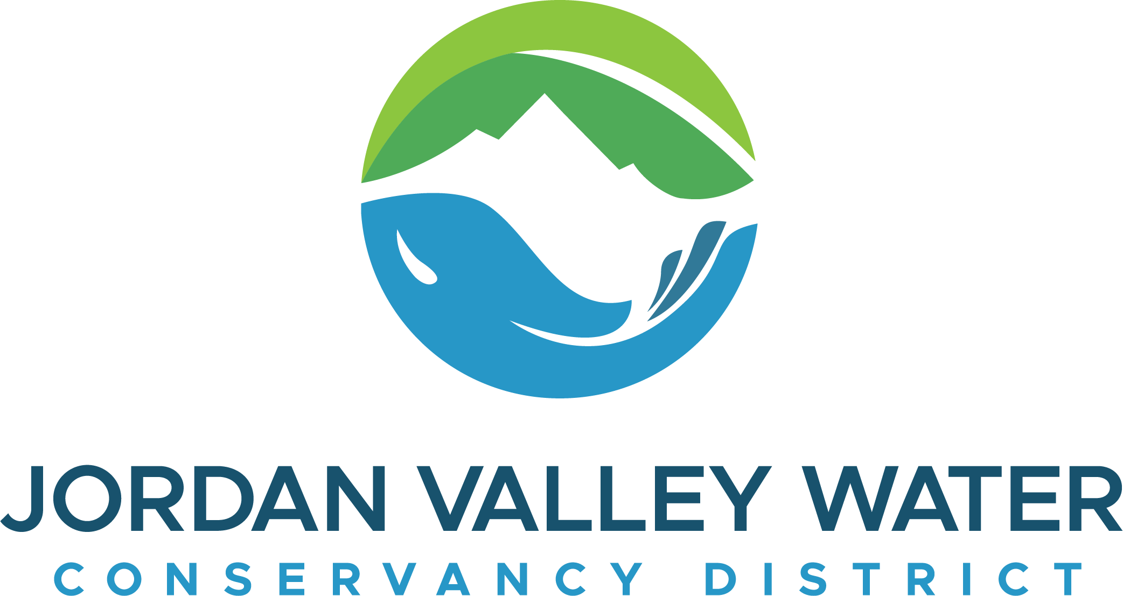

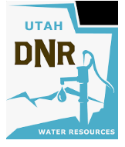

RESOURCES
Jordan Valley Water Conservancy District
8215 South 1300 West
West Jordan, UT 84088
Phone: 801-565-4300
https://jvwcd.org/
Tooele City Water Conservation Report
90 North Main St
Tooele, UT 84074
Phone: 435-843-2130
https://tooelecity.org/
https://conservewater.utah.gov/
https://slowtheflow.org/
WATER CONSERVATION MONDAY WITH THE MAYOR MAY 2, 2022
Notes:
Assigned to: Councilman Tony Graf
The following resources can be found on the Tooele City Website Homepage: https://tooelecity.org/city-departments/finance/utilities/water-schedule/
> Tooele City’s Outdoor Water Conservation Schedule As previously stated, Councilman Brady shared details of Tooele City Water Conservation Schedule.
> Tooele City’s Water Conservation Plan This 30 Page document outlines: Water System Profile; Current Challenges and Opportunities; Current Conservation Practices; Goals; Cost Analysis; Implementation Procedure; Monitoring and Evaluation; Plan Updates and Adoption
> Conservewater.utah.gov: Utah Division of Water Resources water conservation site.
> Conservation Garden Park: Free Events and Classes about Localscapes and Utah friendly plants and flowers.
> Division of Water Resources Weekly Lawn Watering Guide: Updated weekly!
> Home Water Works: Water Usage Calculator, Water Conservation and Efficiency
> Localscapes: Online Classes about Localscapes.
> Slow the Flow – Save H2O: Great Conservation Tips for both Indoor and Outdoor Water Use!
> USU Extension: Center for Water-Efficient Landscaping. Provides research and outreach to help improve the efficient use of water for landscape irrigation.
> Utah Division of Water Resources The Utah Division of Water Resources is one of the seven divisions housed within the Department of Natural Resources. Tasked with Planning, Conserving, Developing and Protecting Utah’s water resources, the Division earnestly strives to be Utah’s water steward.
> Utah Water Savers: Information regarding Program and Rebates as mentioned in previous slide

Slide 11

QUESTIONS & DISCUSSION
Tooele City
435-843-2100
WATER CONSERVATION MONDAY WITH THE MAYOR MAY 2, 2022
Notes:
Questions and Discussions

Slide 12
Join us in for the next
MONDAY WITH THE MAYOR
Email questions to:
mondaywiththemayor@tooelecity.org
(435) 843-2104
Find more information at our website:
www.tooelecity.org
Notes:
Questions and Discussions

